Slide 1
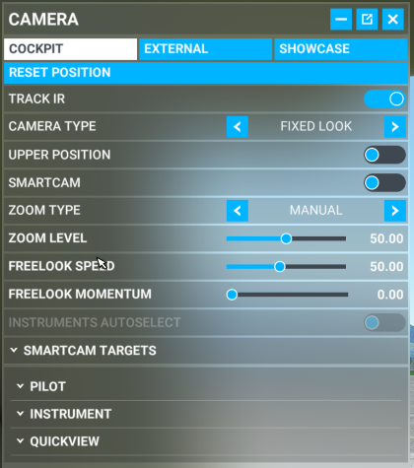
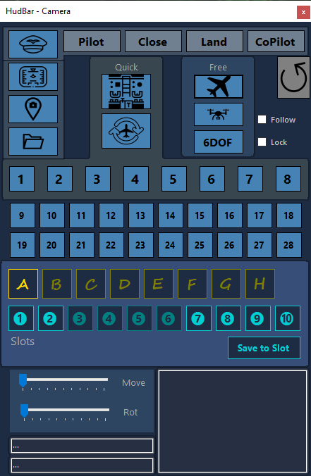
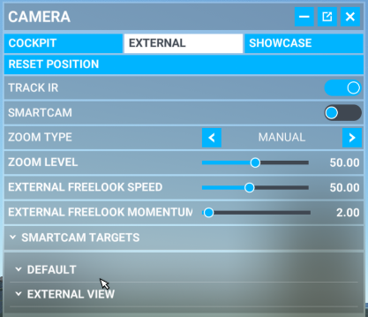
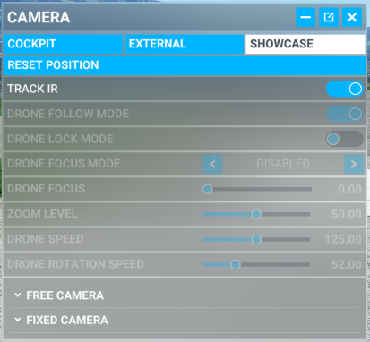
SmartCam

Slide 2
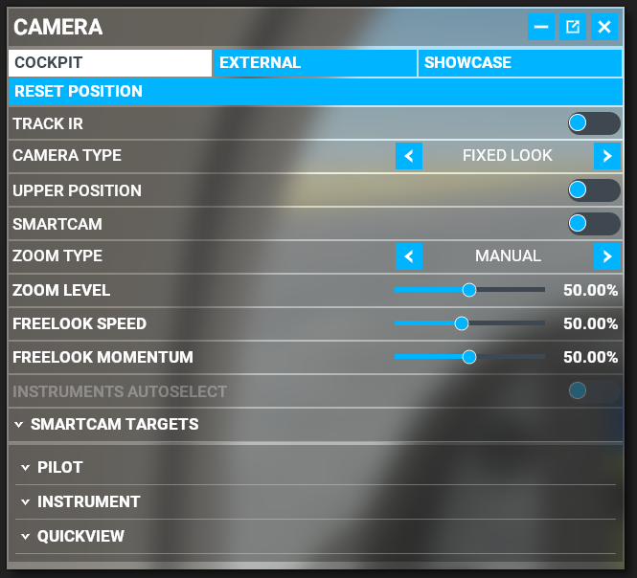
State
SubState
ViewType
Cockpit
External
Drone
Drone Plane
Ground
ShowCase
Locked
Unlocked
QuickView
Smart
Instrument
Default
Pilot
Instrument
Quick
External
Other

Slide 3
NAV1
KASDJS (VOR)
GPS
KASDJS (VOR)
123.22
123.22
123.22
123.22
NAV1
123.22
123.22
Đ KASDJS (VOR)
DIS DTK BRG
DIS DTK BRG
NAV2
123.22
123.22
KASDJS (VOR)
_.__ ___ ___
_.__ ___ ___
DME
123.22
123.22
0.0 ___ __:__
0.0 ___ __:__
ADF1
123.22
123.22
ADF2
123.22
123.22
GS TRK ETE
GS TRK ETE
COM1
123.22
123.22
COM2
123.22
123.22
. . . . . ^ . . . . .
X
. . . . . ^ . . . . .
. . . . . ^ . . . . .
X
X
Tx off
7700
FROM

